Slide 1

The OHIO STUDY
Interviewer’s Guide
to the Galaxy
1.1 Welcome
1.2 Background of the Ohio Study (tOS)
1.3 The Sample for tOS
1.4 A few important definitions
1.5 The Flow of the Ohio Study
Table 1.5a
Table 1.5b
1.6 Your Role as an Interviewer

Slide 2


CHAPTER 1: INTRODUCTION
1.1 Welcome
Welcome to the Ohio Study (tOS). The Center for Human Resource Research (CHRR) is pleased that you are joining our team of Interviewers and other staff who are conducting the fieldwork for this important survey.
Who is conducting the Ohio Study?
Dr. Chris Browning is a professor of sociology at The Ohio State University and our Principal Investigator (PI). He and his colleagues are conducting this research on the day-to-day lives of young people.
CHRR, a part of The Ohio State University, will oversee data collection and dissemination. We will also hire interviewers working in the Columbus area.

Slide 3

1.2 Background of the Ohio Study (tOS)
Studies of children’s development typically focus on what happens within the family or school environment.
This study is intended to collect information on where adolescents spend their time, with whom they spend their time, and how they spend their time. You will conduct home interviews on Days 1 and 8, and the youth will do mini-surveys on a smartphone on Days 1-7.
An important innovation of this study is our effort to collect information on the geographic locations of adolescent activities, in particular risky behaviors such as substance abuse and anti-social activities like stealing and violence. If we know exactly where they are going, and who they are with, families and communities can target areas where there is trouble.

Slide 4
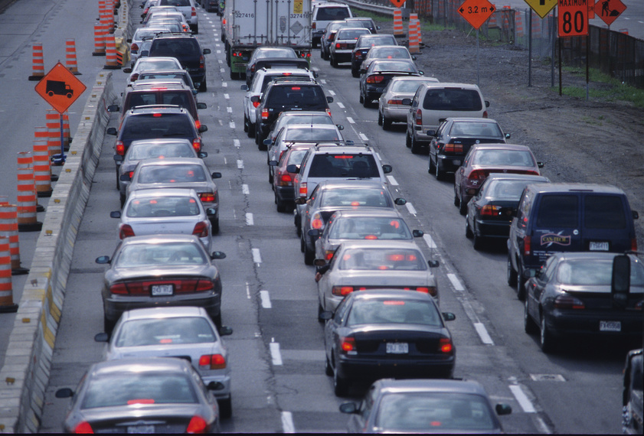
1.3 The Sample for tOS
Our sample for the Ohio Study (tOS) is randomly selected from families inside I-270.
You will be interviewing a RESIDENT parent/caregiver and THE ONE resident child between the ages of 11 and 17 with the most recent birthday. Taking only the youth with the most recent birthday randomizes which youth in a household (HH) is interviewed, thereby preventing a bias that could invalidate the results.
We refer to the adult resident in the sample as the Parent/Caregiver (P/CG) and each youth in the sample as the young person or youth.
Permission to interview the young person must be given by a parent or guardian. Although we prefer that the household information be collected from a resident parent to the eligible youth, this information can be collected from any adult resident in the household. Some households will also be given the opportunity to contribute saliva and hair.
So ONE adult and ONE child from each household will be interviewed. The youth can not be switched with other household members. You will interview these two people, in their home, on Day 1 and Day 8.
The Ohio Study will provide a smart phone for the youth to carry on Days 1-7, both to track the actual locations of the youth, and so the youth respondent can answer mini-surveys (EMAs) from time to time.
Remember! The sampled young person must be of ages 11 – 17 with the most recent birthday and living at the sampled residence.

Slide 5
The first pilot in 2011 tested our ability to capture latitude and longitude in a survey. The expanded 2012 pilot tested our ability to capture a matrix of
who/what/when/where in real time, and retrospectively.
Ultimately, we would like to understand how families, peer networks, schools, and neighborhoods work together to influence children’s lives.
Now that all the pieces are field-proven, we’re going after a longitudinal sample of thousands 2013/2014.
This is the MOST complicated project we have ever done: 2 home visits, 35 self-administered mini-surveys, saliva and hair from selected households and a time/place/activity/person matrix! Later we’ll be adding the opportunity for some households to participate in an MRI. CHRR technical staff appreciates all questions, comments and criticisms regarding any aspect of the project. Due to the nature of the research, however, we are not able to change question wording unless it’s clearly a mistake. Even if it sounds dorky, it is what it is.

Slide 6
Respondent Incentives for participation:
MONEY
Parent Survey: $25
Youth Survey: $25
Saliva: $30
Hair $30
Community Service Certificate
BUCKEYE Raffle
The most any HH can receive is $100.00. HHs who aren’t part of the biomarker experiment will only receive $50.00.
If the parent and the youth decide to participate, we will provide them with a certificate for community service hours. The Youth will also be entered in a monthly raffle to win OSU related prizes.

Slide 7
tOS is using new technology and procedures that go far beyond what was done in the pilot studies, including some very sensitive questions on risky behavior such as sexual activity and drug use.
It is important to collect this information and protect their privacy at the same time.
Several steps are taken to help ensure this:
First, you will not be collecting the full names of the youth’s family and friends (network partners); instead, we allow the respondent parent and youth to make up nicknames or just give us their first name and the first letter of their last name to protect their privacy.
Second, we want to respect the privacy of the Youth in particular. If at any time there is someone near enough to hear yourself and the Respondent, and you think the survey questions might be sensitive, turn the laptop to the R and allow them to read silently and point to the answers.
Except as provided by law, any personal information given you will be kept confidential and secure by you the interviewer and the project staff at CHRR.
If you see or hear evidence of child abuse, you must report it to your FM as soon as you leave the HH.
Any information collected by the web survey will be kept confidential and secure in a database at The Ohio State University.

Slide 8
1.4 A few Important Definitions
●PII=Personally Identifiable Information. That is, information that can be used to link a respondent to confidential data or a particular survey.
● R=Respondent, Resp, Participant. Youth R is the 11-17 year old with the most recent birthday. Parent R is parent of the Youth R.
● CAPI=Computer Assisted Personal Interview, the interviewer records the answers on the laptop, often used in complex surveys to improve data quality by using trained personnel.
● CASI=Computer Assisted Self Interview, The R records his/her own answers directly on the laptop, often used for gathering sensitive information when lack of privacy is a concern.
● EMA=Ecological Momentary Assessment is the mini-survey the youth will complete by themselves on Days 1-7.
● Conversion=Converting a contact into a fully consented Respondent (R).
● QR Code=A 3-dimensional bar code used to link from a cell phone camera’s picture to a web address.
● Consent=Agreeing to participate for oneself.
● Permission=Giving permission for someone else to participate (usually an adult for a minor).
● Assent=Agreeing to participate after someone else has given permission (usually asked of a minor).
● HH=household= includes all the persons who occupy a housing unit.

Slide 9

Section 1.5 The flow of the Ohio Study (also on your desktop)
PHONE Screener 1489 and Tracking 1496:
Screen HHs for eligibility, convert contacts into willing participants.
Set appointments.
HOME VISIT 1, Day 1:
Establish rapport, answer questions; obtain Consent, Permission and Assents
Youth Self-Administered Survey 1491
Adult CAPI Survey 1493
Adult Self-Administered Survey 1490
Youth CAPI Survey 1492
Teach Youth how to use the smart phone
If eligible for bio-marker collection; teach Youth (and parent if possible) saliva collection procedures
DAYS 1- 7
The Youth will receive 5 two-minute surveys each day on the smart phone we provide.
HOME VISIT 2, Day 8:
Finish Adult CASI 1490
Youth Exit Graphic Survey
Finish Youth CAPI 1492
Collect final saliva sample if this is a biomarker HH
Collect hair sample if this is a biomarker HH
Collect equipment
Distribute incentives and have all receipts signed
Return samples and receipts to CHRR (You will only be credited for interviews where we receive consents, permissions AND receipts)

Slide 10
1.6 Your Role as an Interviewer
Your role as an interviewer is vital to the success of the Ohio Study.
Possible contacts will be loaded in the screener. You will have the name, address, phone number and caseid in grid form on your screener survey.
Start calling as soon as possible. Vary the times and days you try numbers. If you determine that the phone number is incorrect or out of service, mark it on the screener. Research staff at CHRR will review these cases and work to locate a better number for these households.
Gain respondent cooperation by explaining the significance of the respondent’s participation in this survey.
You are the face of The Ohio State University and the Ohio Study! Conduct your interviews in a professional and courteous manner. Be clean, well-dressed, polite and punctual.
You’re our ultimate source for this information, and we depend on you to provide us with accurate data so we can review our overall progress and budget throughout the field period.

Slide 11

REVIEW:
After reading Chapter 1, you should be able to answer the following questions:
1. What are the three main things that tOS wants to learn about how children spend their time?
2. Which must be given first-permission or assent?
3. What is the age of Youth we are surveying?
4. True or False: CASI refers to an interviewer using a computer to survey the R.
5. True or False: Parent/Caregiver and Youth must live in the same HH.
(answers follow)

Slide 12

The Answers:
1. Where they spend their time, with whom they spend their time, and what they are doing at that time.
2. Permission by the parent, then assent from the Youth.
3. 11-17 Years
4. False, CASI is self-administered (Computer Assisted Self Administered).
5. True

